Slide 1
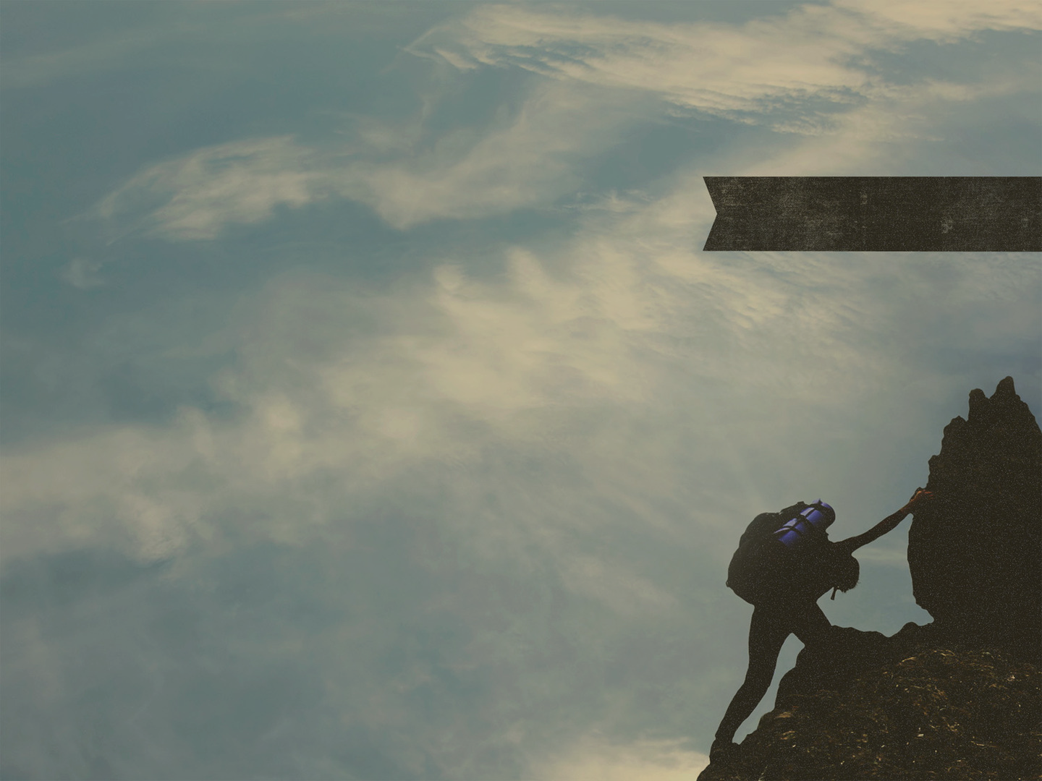
PATIENCE IN SUFFERING
James 5:7-11
Notes:
Good morning everyone. I hope you are all doing well
Well we are in our second last sermon, and I’m focusing on James 5:7-11 today, so if you want to open your Bibles there
If your wondering if I forgot about verse 12, I didn’t, the context of these verses, leaves verse 12 a little disjointed with it all, so I decided to give a few thoughts on verse 12 in the thought for the week, if you want to check that out later
This week, I had a phone call with someone from this church, and we were discussing a number of things about the book of James
But one of the things we were discussing is of particular importance and relevance in understanding the context for which James is writing these verses we are looking at today
In James 1:2, and verse 12 we see James talking about counting it all joy and remaining steadfast under trials
Then in verses 13-15 James addresses temptation
Then he discusses favouritism at the beginning of chapter 2 and urged them to show mercy
Then at the beginning of chapter 4, James addresses the quarrels that are happening among them
And then in last week’s passage which Greg preached on, James addresses the rich non-Christians who are oppressing the poor.
And the language James uses in James 5:1-6 is strong language
And it basically ends with James stating that the Lord will bring justice, and vengeance will be His
So it is clear that James’ audience is under a tremendous amount of suffering, trials, temptations and persecution
And yet in the face of all this, James in today’s verses basically says this, “Chin up, be patient, because a better day is coming”

Slide 2
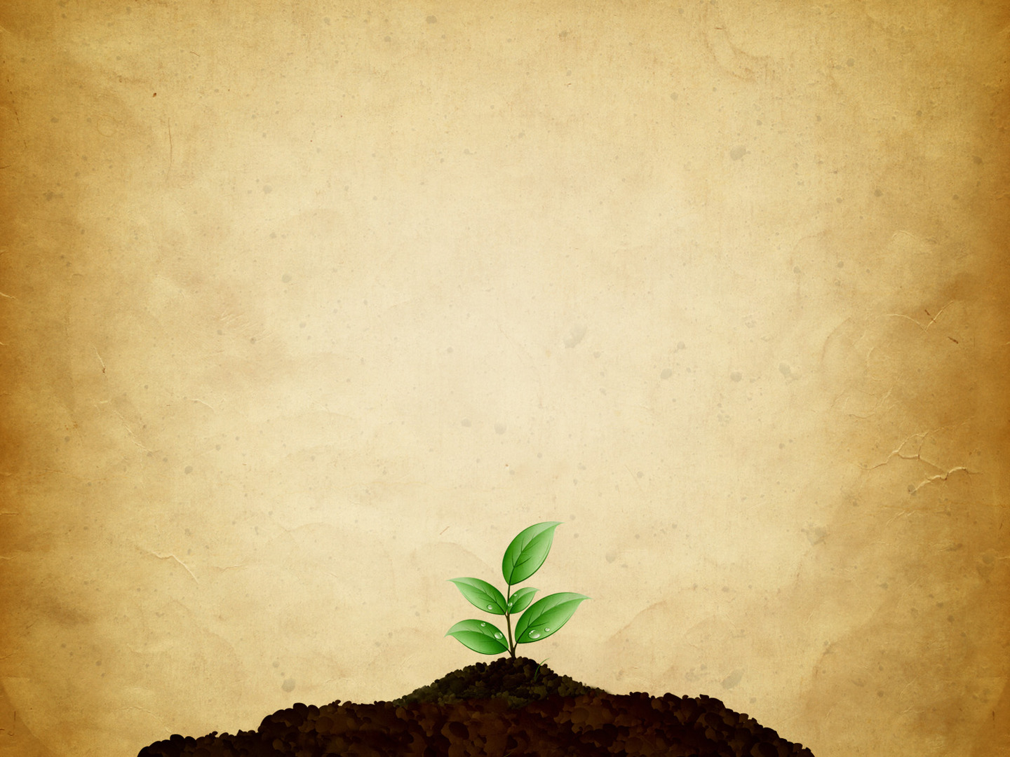
BE PATIENT
“Be patient, therefore, brothers” (James 5:7a)
“Until the coming of the Lord” (James 5:7b)
“See how the farmer waits for the precious fruit of the earth” (James 5:7c)
Notes:
”Be patient, therefore, brothers” (James 5:7a) - Now we know that whenever we see ‘therefore’, we need to go back and read what has just been written - Which James addresses the rich people, which has a lot of general application for us today - And if we look closely at those verses, James is addressing the rich unbelieving oppressors of the time - And then verse 6 ends basically stating that vengeance will be the Lord’s. God will repay all the deeds of the wicked… - And so in light of this, James says to the Christians, and to us, whatever suffering you have, whatever trials you may be going through, be patient Christian - The word here for patient, literally translates to be ‘long-tempered’. - When someone gets angry quickly, or has a short fuse, we say they are short-tempered - James is urging us, commanding us to be the opposite, to be long-tempered, to be long-suffering, to endure - Though times are tough, though the rich are oppressing you, though there is favouritism among you, be slow to anger, be long-tempered - James is saying, you can be gracious, and patient towards your oppressors, and all people who come against you - Because first and foremost, God is gracious and patient towards you - The only reason we are saved, and that God continues to deal with us is because He is long-tempered, and patient with us - In my own life, as a born-again believer, I have failed in so many areas of my life, and I still continue to sin - And yet God in His grace does not cast me aside, but every time I sin, He calls me to repentance, and forgiveness, and still calls me His own - And if God is so gracious and merciful with me, then how dare I not treat others the same - So, if an infinitely holy and just God, can be gracious and patient with unholy sinners, - Then we ought to, by the power of God at work in our lives, be patient and gracious towards others - How though? How can I be patient and cultivate this attitude in the face of such severe opposition?
“Until the coming of the Lord” (James 5:7b) - We can be long-tempered, we can be patient, because we know that there is a day when Jesus is returning - The word here for ‘coming’ is the word “Parousia”. - It’s the most common New Testament word used to refer to the second coming - It means more than just coming, it better translates to, ‘Until the arrival of the Lord’ - Jesus comes and arrives, and he is present. - Be patient until our king returns and is present with his people to bless us with his presence - 1 out of every 13 verses in the New Testament makes a reference to the second coming of Jesus Christ. So it matters what we believe about the end times - It matters that we think constantly of the return of Jesus Christ. - 3x in these 5 verses James refers to the return of Jesus - The church has always lived in certain hope of the second coming. - But there is a sense in which the persecuted church, lives even more in light of it - They know that with every waking moment, though this world in its fallen state may be corrupt and dark, God has a purpose for all this suffering - And at the end of the day, the only hope which the persecuted church clings on to oh so tightly, is that one day Jesus will return to make all things right - And whilst I do not ask for the kind of suffering that is going on here in this passage, there is a sense in which I know that God would use it to sanctify us as a church - Churches need to be more heavenly minded, fixing our hearts and minds on the return of Jesus, and it is through the flames of affliction that God helps us to do this - That we might live our lives with greater urgency in light of the imminent return of Jesus Christ - So James is saying, be patient, for we have a certain hope, and blessed assurance, that Jesus is coming back and he will gather the church into his presence - 2 Cor 4:16-18, “So we do not lose heart. Though our outer self is wasting away, our inner self is being renewed day by day. For this light and momentary affliction is preparing for us an eternal weight of glory beyond all comparison, as we look not to the things that are seen, but to the things that are unseen” - Our hope lies in the coming of the Lord which is not yet seen
“See how the farmer waits for the precious fruit of the earth” (James 5:7c) - The farmer waits, not idly. But he recognises that there is only so much he can do. He waits for something outside of himself - He has worked the field, planted the seed, but he cannot force the plant to grow - No matter how much he works, or how many hours he puts in, the seed will grow no faster - So he waits, he depends upon the providence of God - He depends upon God for the precious fruit. This has been his life’s work, he has shed blood sweat and tears, only to have to place it all into the hands of God - And so it is with us, the Christian life is filled with joy, but in that joy is suffering, trials, temptations, but we do it for the precious reward of eternal glory with our Lord and Saviour - We commit, trust, obey and surrender our lives, that’s our part, but in doing that we commit ourselves to the Lord, for it is His work in us. It is by His grace that we persevere - It is by His grace that we fight the good fight, and it is by His work in us that we are able to do good works - Wait upon the Lord, and you will receive that reward which is so precious

Slide 3
“Being patient about it, until it receives the early and late rains” (James 5:7d)
If a farmer can wait for the harvest, shall we not wait for the coming of the Lord?
We wait and long for that day, while doing the Lord’s work. Here we must toil, and in heaven we rest
Notes:
“Being patient about it, until it receives the early and late rains” (James 5:7d) - Are you getting the picture. James has said, be patient, wait, be patient - The fruit of the Spirit is patience, and so the command is, BE PATIENT - Be patient, wait upon the Lord and by the grace of God, He will do the work in you - The farmer waits upon the early and late rains - The early rain would come around October, and it would prepare the soil for the seed and help the seed in growing once it was planted - The late rains would then come in March and April, swelled the grain and guaranteed a good crop - But it was a process, which in the Christian life, we call that process, sanctification. - That by the grace of God, we have the privilege of being able to read and study the Word of God, and having the word of God preached to us - And come before the throne of grace in prayer. God will day by day, through these ordinary means of grace, conform us to the image of Christ, until Jesus returns when we are glorified and sin will be no more - Nothing can hurry this process along, we simply trust in the Lord every day that He gives us breath, and live for His glory, for this is the life of the Christian
If a farmer can wait for the harvest, shall we not wait for the coming of the Lord? - If a farmer can patiently wait for fruit to come out of the ground, then we can wait, not idly, but with urgency and expectancy in the way we live our lives - The farmer is patient and endures so much for a little fruit. - Shall we not be patient, endure, press on, persevere, until the day of refreshing when Jesus returns - Oh that we would be more heavenly minded
We wait and long for that day, while doing the Lord’s work. Here we must toil, and in heaven we rest - Here we have the Scriptures and the commands of the Lord by which we are to submit - Here we have the great commission, to go about and share the gospel, with a great sense of urgency knowing that Jesus will return - But we do so knowing that to suffer for Christ is a privilege, because he suffered the wrath of God for all who would believe - So we endure, we are patient knowing that all of this does not rest in my hands, but in the hands of our sovereign and good God

Slide 4
ESTABLISH YOUR HEARTS
“You also, be patient. Establish your hearts” (James 5:8a)
“For the one who doubts is like a wave of the sea that is driven and tossed by the wind…he is a double-minded man, unstable in all his ways” (James 1:6, 8)
“For the coming of the Lord is at hand” (James 5:8b)
Notes:
“You also, be patient. Establish your hearts” (James 5:8a) - Again, be patient and then the command to establish your hearts - As 1 Peter 5:10 says, “And after you have suffered a little while, the God of all grace, who has called you to his eternal glory in Christ, will himself restore, confirm, strengthen, and establish you” - The wonderful tension of Christian living is that it is God who does the work, it is God who establishes our hearts. - He gets all the credit, He gets all the glory, but we must make the commitment - It’s tension between the sovereign work of God and our response. As the Holy Spirit works in us, we commit to the work of Spirit - The root word for establish means to prop yourself up. It’s an attitude of firm courage and commitment - Christians are to be people who stake their claim, establish their hearts in the Word of God, on the person and work of Jesus Christ, because it is the gospel of the Bible that saves. - The Bible is a firm foundation, and it is in it that we establish our hearts, for though we may fail, God will not - And we know from earlier chapters how James feels about unstable people, those who have not established their hearts
“For the one who doubts is like a wave of the sea that is driven and tossed by the wind… he is a double-minded man, unstable in all his ways” (James 1:6, 8) - In James 4 he calls out some of the people to cleanse their hands and purify their hearts, for being double-minded in calling themselves Christians but being friends with the world - And now in their time of great suffering and persecution he say, ”establish your hearts, take courage”, why?
“For the coming of the Lord is at hand” (James 5:8b) - In the Greek it reads that Jesus is right on the edge, it’s just about to happen - This is called the doctrine of immanency. Which means the return of Jesus Christ could come at any moment. - In 1 Thessalonians we are told that with the trump of God resounding and the voice of the archangel, Jesus will be here - And so be patient and live your life in light of the fact that Jesus could return at any moment. - It is this kind of anticipation and expectation that impacts the way we live for Christ - This is why we need to preach the whole gospel, the whole counsel of the Word of God. - Because people need to know that suffering is expected in the Christian life - That we live in a fallen world, that your only hope of being saved from an eternity in hell as a consequence for our sins - Is if you will repent and believe in Jesus Christ as Lord and Saviour. Your best life is not now - But it lies in eternal glory with our heavenly Father, but in the meantime we suffer, and persevere, and share the gospel, because the coming of the Lord is at hand - If nothing else, we are 2000 years closer to the return of Jesus than when James wrote this letter. - So let us look to the coming of Jesus, and remember that’s where our hope lies

Slide 5
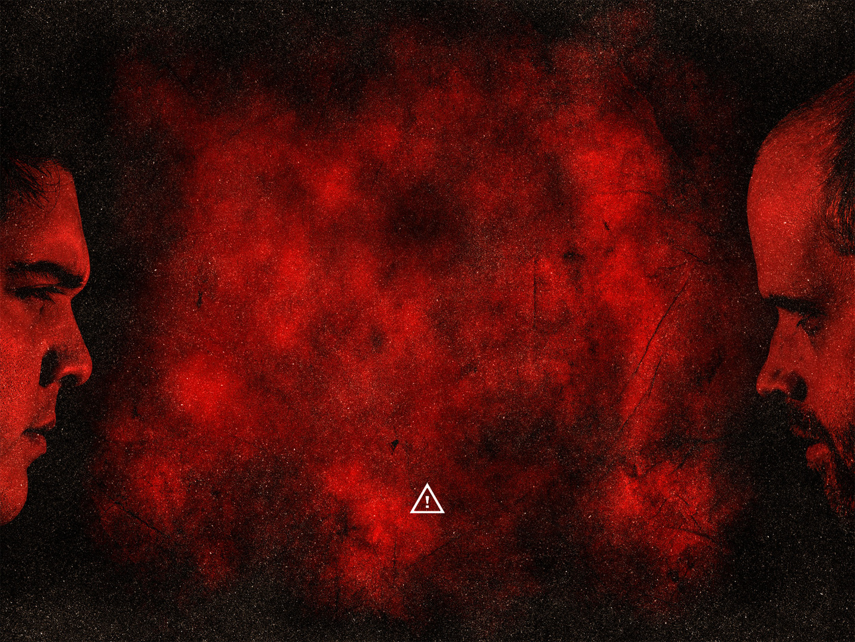
DO NOT GRUMBLE
“Do not grumble against one another, brothers” (James 5:9a)
“So that you may not be judged” (James 5:9b)
“And the people complained in the hearing of the Lord about their misfortunes, and when the Lord heard it, his anger was kindled, and the fire of the Lord burned among them, and consumed some outlying parts of the camp” (Num 11:1)
Notes:
“Do not grumble against one another, brothers” (James 5:9a) - So we see in verse 7-8, James tells us what to do. Be patient, establish your hearts, and look to the coming of the Lord - Verse 9 then proceeds to tell us what not to do. - To grumble is to sigh, or moan inwardly out of pain, grief or sorrow - It is in these times of suffering and trials, when you are down to your last nerve, that you will be prone to grumble against one another, that you will lash out at your fellow Christians using bitter words - But don’t do it, it is in this time of suffering that you need one another. - The way this is phrased grammatically is the same that issues a cease and desist order - James is saying STOP grumbling, it’s a call to repentance. Why?
“So that you may not be judged” (James 5:9b) -Both believers and unbelievers will all be judged, we see this in 1 Corinthians 3, and 5 - And then in 2 Cor 5:10 says, “For we must ALL appear before the judgement seat of Christ, so that each may receive what is due for what he has done in the body, whether good or evil” - For the Christian, this judgement is not one of our salvation, for our salvation is secure in Christ today, if we have placed our faith in Christ - The Christian will not face God’s wrath on judgement day, but we will face God’s assessment of every word and every deed - This sin of grumbling is a sin that churches need to take seriously, we need to confront it and deal with it, and repent of any grumbling that goes on in the church - Now you may be thinking, James is coming down a little hard on such a minor sin, but let’s go back to the Old Testament in Numbers
“And the people complained in the hearing of the Lord about their misfortunes, and when the Lord heard it, his anger was kindled, and the fire of the Lord burned among them, and consumed some outlying parts of the camp” (Num 11:1) - We see here that grumbling lips invoked divine judgement. - The people grumbled and God heard it. God’s anger was kindled and God judged them - This is righteous judgement. And what’s even worse is the people didn’t even learn their lesson - Because in chapter 14 Israel grumbled again saying that they wanted new leaders besides Moses and Aaron - And then for that grumbling and their lack of faith, God would force them to wander in the wilderness for 40 years before they would proceed to enter the promised land - And then again in chapter 20 they grumble, wishing they had been left in Egypt. - Here’s the problem with grumbling. When we grumble we assume we are entitled to something - And it causes us to forget the goodness of God, and the sovereign hand of God which has been at work every step of the way - God’s judgement against grumblers is righteous. - Because in grumbling Israel forgot that God had delivered them out of slavery in Egypt and brought justice to the people of God in bringing forth the 10 plagues on Egypt – They had forgotten that while they wandered in the wilderness for 40 years, every day they woke up, God provided bread from heaven. - Every step of the journey God made sure their clothes didn’t wear out, and the heels of their sandals didn’t wear down - Every time they went to battle, God fought their battles and brought victory - And the second it got hard they grumbled, completely forgetting the fact that every step of the way, God had been providing – And yet we do the exact same thing every time we grumble. When we grumble against a fellow Christian, we forget that we are all sinners saved by grace and it is by grace alone that we will go to eternal glory - And so James is saying, “I know times are tough, but the Lord is just, be patient, look unto the coming of the Lord, and do not grumble, stay firm - Continue to remind yourself of the gospel and how it is that you have been saved, and it is in doing this that you will find yourself being patient towards others”

Slide 6
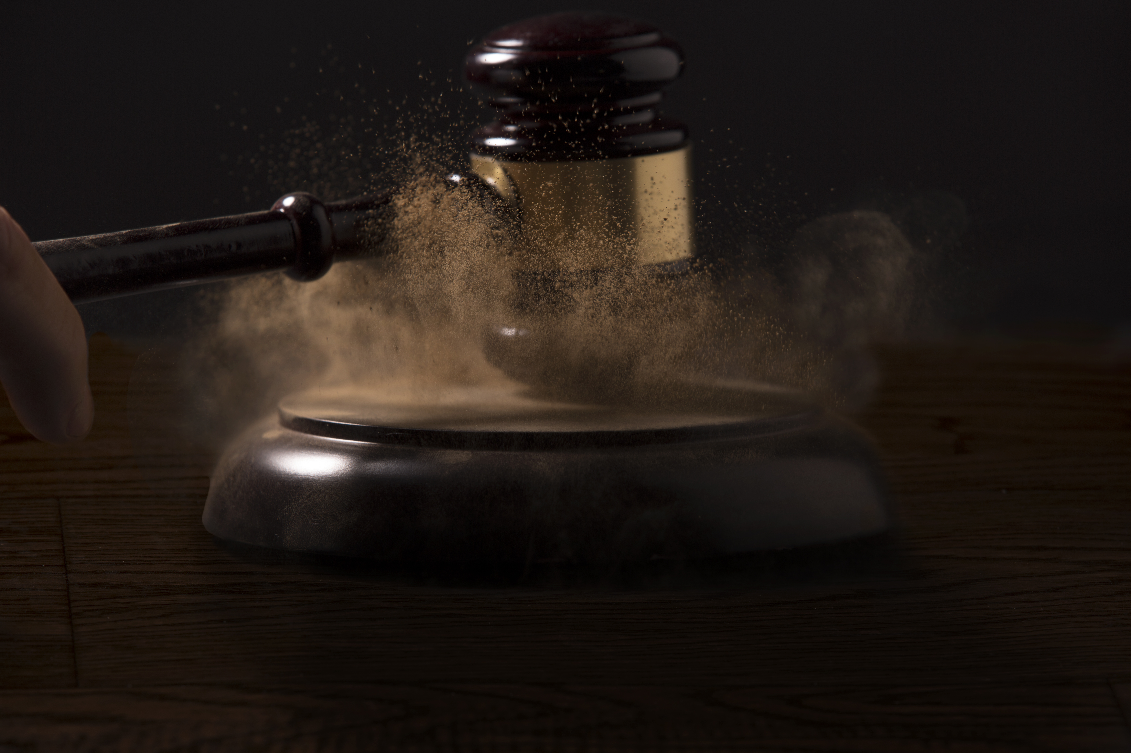
“The Judge is standing at the door” (James 5:9b)
James is emphasising, that to be patient, to persevere, is going to require constant fixation on Jesus coming again
Notes:
“The Judge is standing at the door” (James 5:9b) - The fact that, Jesus, the Judge, is standing at door, implies suddenness in judgement - Again, like in verse 8, James is telling us that Jesus return is imminent – And the nearness of Jesus return should awe us into doing the work of the Lord - Matthew 24:33, “Therefore you also must be ready, for the Son of Man is coming at an hour you do not expect”
James is emphasising, that to be patient, to persevere, is going to require constant fixation on Jesus coming again - In 3 verses, 3x James has commanded patience and 3x James has emphasised the fact that Jesus return is imminent - Saint, be patient for Christ is coming, he is going to reward you, bless you, and take you to heaven - And you’re going to be patient because you don’t want to sin. We will sin, but we don’t want to, because the Holy Spirit now dwells in us - We positively look to the coming of Christ and negatively look at the judgement. - Our hope, and the love of Christ motivate us to be patient, - But there is also an element of fear which comes into play - It is a fear of God’s judgement, of disappointing our heavenly Father, because we want to do that which pleases Him - Brothers and sisters in Christ, look up, look to the Lord, for your eternal security lie not in the things of this earth, but in Christ

Slide 7
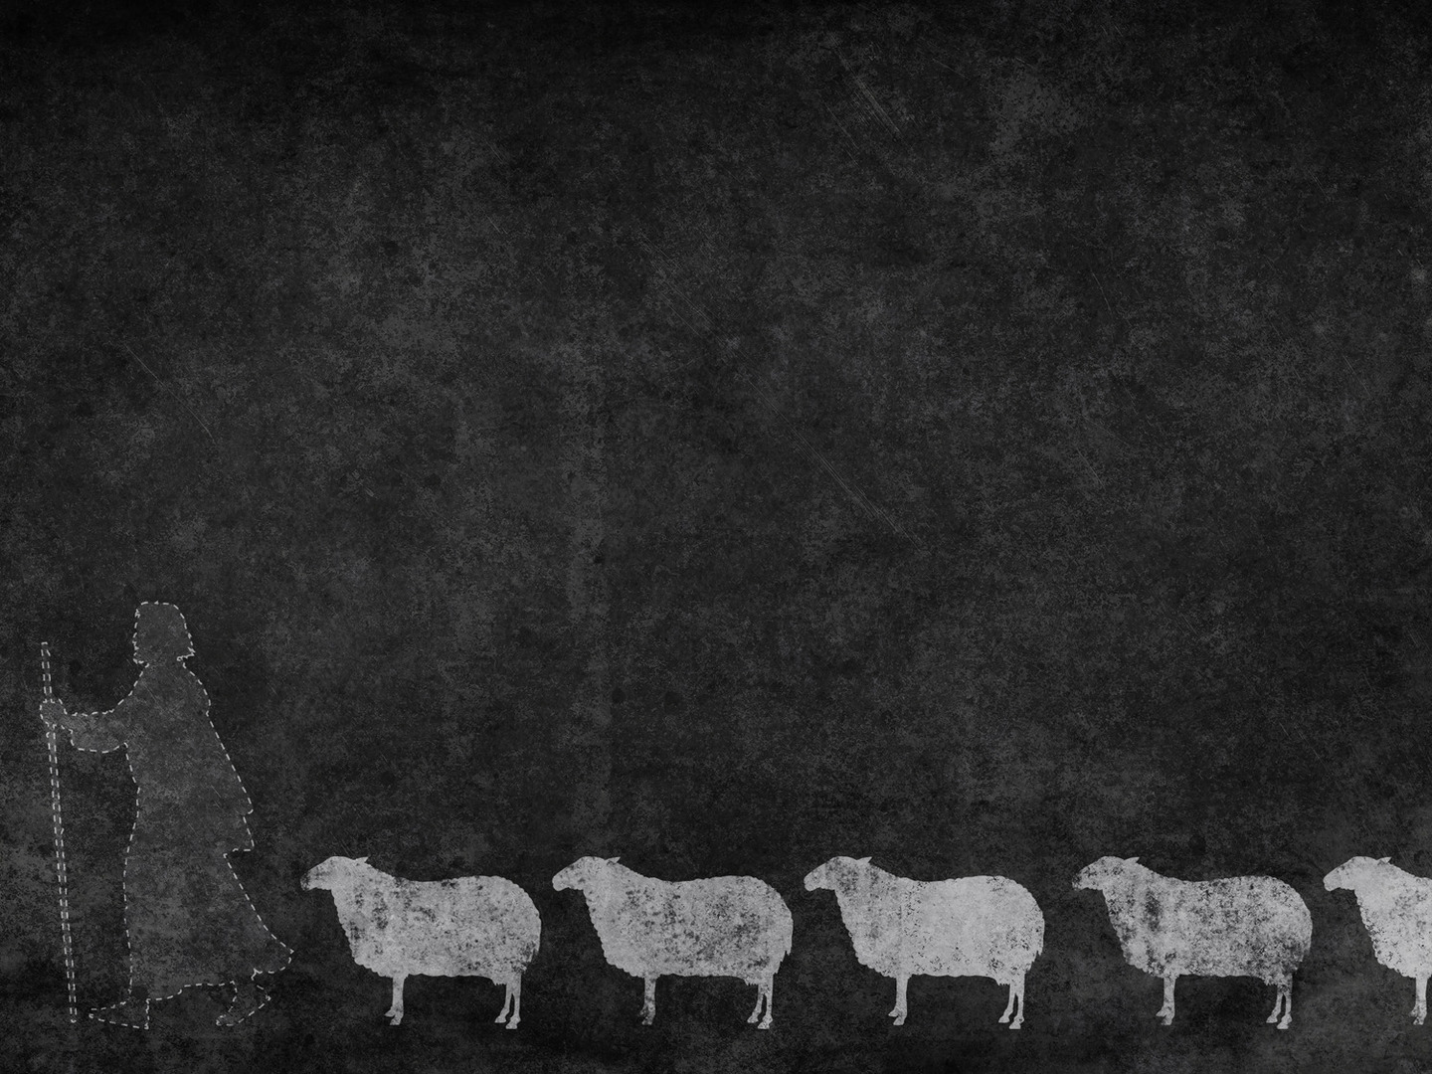
FOLLOW GODLY EXAMPLES
“As an example of suffering and patience, brothers, take the prophets” (James 5:10a)
“Who spoke the name of the Lord” (James 5:10b)
“Behold, we consider those blessed who remained steadfast” (James 5:11a)
Notes:
“As an example of suffering and patience, brothers, take the prophets” (James 5:10a) - Verses 7-9, in order to endure and be patient, James urges us to look to the Lord - And then in the last 2 verses, James now says, you can also look to the godly examples that have gone before you - And specifically he refers to the Old Testament prophets - We all need godly examples in our lives, so that when times get hard, when we are waiting and being patient we can look around and remember we are not alone - That many have gone before you who have suffered for the sake of the gospel, and who have had to be patient – This can give us great courage to press on in the faith
“Who spoke the name of the Lord” (James 5:10b) - So as we said, James is referring to the Old Testament prophets, who his Jewish audience would have been very familiar with - We are talking about Isaiah, Jeremiah, Ezekiel, Daniel, Hosea, Elijah - These were all people who would day in and day out go to the nation of Israel and boldly declare the word of the Lord, - I mean they are literally speaking the words of the Bible that we have today - They were the mouthpiece of God - They should have been celebrated, praised, and honoured. - But we know that if there are 2 things that the prophets had in common, it was that they spoke in the name of the Lord, and they suffered greatly for doing so - God sent prophets to call His people to repentance, that they might come back to Him, and instead of heeding the word of God, and turning from their sins - They persecuted them, rebuked and mocked them, stoned them, and killed them - Being a child of God, faithfulness and obedience to the Scriptures, does not guarantee an easy life or favour with the world - Christian, we have the guarantee of suffering, for though the gospel we preach is one of good news, and it is the only gospel by which one may be saved - It is a gospel that offends, and we go out as sheep amongst wolves - These prophets were told by God Himself that the people would not listen - But the prophets continued to do the will of the Lord even though they suffered - They persevered, knowing that one day, their suffering will cease, and they would gaze forever into the glory of God, and would be welcomed home into the arms of their heavenly Father - Don’t let anything that Satan or this world throws at you, stop you from doing the will of God. - Because the darkness, and suffering and sickness, and sin that wreaks havoc on this world will one day cease - But being in glory with Jesus Christ, our Lord and Saviour, will go on for eternity.
“Behold, we consider those blessed who remained steadfast” (James 5:11a) - This is very reminiscent of Jesus in the sermon on the mount where he said, “Blessed are you when others revile you and persecute you and utter all kinds of evil against you, falsely on my account.”(Matt 5:11) -It takes a Christo-centric view, to view those who suffer and remain steadfast as blessed - This says to the Christian, you’re not only blessed when the sun is shining, the beach is good, and everything is going well in life all due to blessings of God - But even in the midst of your darkest times, your greatest trials and temptations, as you hang in there with God, you are blessed - Christian you are blessed regardless of what happens in your life because in God you find and have all that you need. - Though you are weak He is strong, and may He keep reminding us of our weakness, so that we may never forget that His grace is sufficient and apart from Him we have nothing - And it is in Christ and Christ alone that I find all my hope, and joy, and not in the things of this life

Slide 8
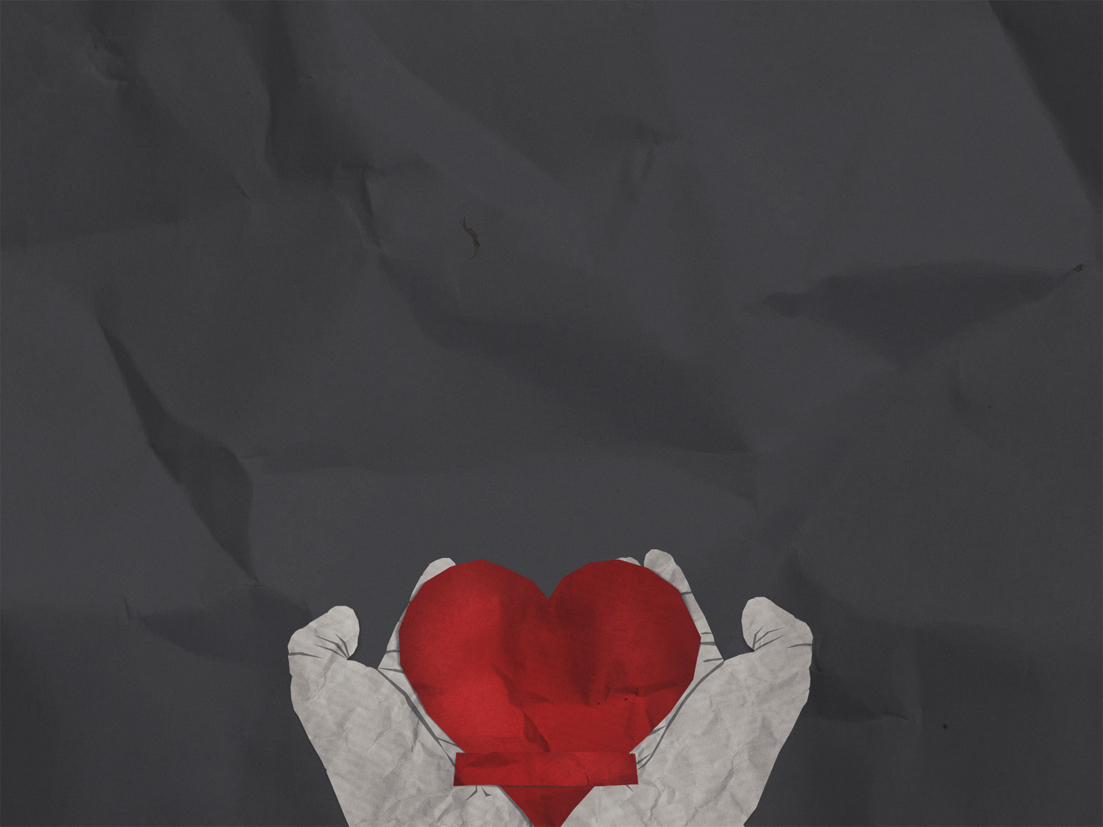
“You have heard of the steadfastness of Job” (James 5:11b)
“And you have seen the purpose of the Lord” (James 5:11c)
“How the Lord is compassionate and merciful” (James 5:11d)
Notes:
“You have heard of the steadfastness of Job” (James 5:11b) - James is saying that Job is famous for misery and for steadfastness, for perseverance, for patience - Throughout his life we see that he had times of weakness where he questioned and failed in some areas - But generally it is a story of humility and seeing that God is sovereign over every aspect of our lives - Steadfastness or perseverance is being under a heavy burden, but not giving up regardless - Job 13:15 says this, “Though he slay me, I will hope in him”. - Though God may allow me, and choose a course for me that allows great suffering. - Job is saying, even if God kills me, still you can’t stop me from trusting him, for such was the steadfastness of Job - Though Job was faithful to God, James brings up the story of Job that we might see that it was God who was faithful to Job no matter what
“And you have seen the purpose of the Lord” (James 5:11c) - The story of Job is not a story about Job but a story about the purposes of God - Here’s what I want you all to think about. - I don’t know what each and every one of you is going through right now, but hang in there, be patient, persevere, because there is purpose in your pain and suffering - God’s purpose with Job was to test his faith and strengthen his faith to see God more clearly - James has been urging his audience all along, look to the coming of the Lord, look to Jesus, his coming is at hand, look up Christian - Why? Because if you look down right now, and look around in the thick of it, it will seem as though Satan has won. - But if you look to the end, you will see that God will work it all together for the good of those who love Him - James 1:12 – “Blessed is the man who remains steadfast under trial, for when he has stood the test he will receive the crown of life, which God has promised to those who love Him” - God has a purpose, so look up to the coming of the Lord, and know that when he returns he will lay on your head the crown of life - Why?
“How the Lord is compassionate and merciful” (James 5:11d) - And in that purpose that God has for you through the pain, never forget that the Lord is compassionate and merciful - Those reading James’ letter are just being hammered, they are struggling in their faith, and they are being faced with trial after trial, and persecution from the rich, and favouritism in the church - They are under a tremendous amount of stress and suffering, and then James just reminds them - Remember who it is that you serve, because through it all, you can lean on, and trust in the one who saved you from your sin, and an eternity in hell - The Lord is compassionate and merciful. - “But this I call to mind, and therefore I have hope: The steadfast love of the Lord never ceases; his mercies never come to an end; they are new every morning; great is your faithfulness.” (Lam 3:21-23) - His mercies are new every morning, He has a purpose in your pain, we serve a good God who is sovereign, so take hope saint. Persevere. Remain steadfast.

Slide 9
HOW DO WE BE PATIENT IN SUFFERING?
Look to the coming of the Lord, and know that his return is imminent
Establish your hearts
Do not grumble
Look to the example of those who have gone before you
Notes:
Look to the coming of the Lord, and know that his return is imminent - If we are going to remain patient in this life, even in our times of greatest suffering, we must remember the certain hope we have which rests in Jesus Christ and his imminent return - Jesus will return because God is faithful to His Word, and His promises are sure.
Establish your hearts - Be strong, be firm, strengthen your hearts - Build upon the firm foundation of the Word of God - Commit yourself to His Word and be men and women of prayer - Establish yourselves in Christ
Do not grumble - People will make you frustrated and your suffering will bring you to wits end - Which is why it is imperative that we establish our hearts - Reminding ourselves that God has been infinitely gracious and patient towards us - And it kindles the Lord’s anger and displeases God when we grumble, so stop, repent and cease to grumble
Look to the example of those who have gone before you - Know that many have gone before you and many will come after you who will suffer for the sake of the gospel, and like them we will suffer for proclaiming the gospel - But know that the Lord has a purpose in it all - And for all who have repented and believed in Jesus Christ as Lord and Saviour - One day, when the Lord calls you home, suffering will be no more, there will be no more tears, no more disease, no more death - And we will have been set free from the penalty, power, and presence of sin
Let me close with this:

Slide 10
“A Christian knows that death shall be the funeral of all his sins, his sorrows, his afflictions, his temptations, his vexations, his oppressions, his persecutions. He knows that death shall be the resurrection of all his hopes, his joys, his delights, his comforts, his contentments.” Thomas Brooks
Notes:
“A Christian knows that death shall be the funeral of all his sins, his sorrows, his afflictions, his temptations, his vexations, his oppressions, his persecutions. He knows that death shall be the resurrection of all his hopes, his joys, his delights, his comforts, his contentments.”
So be patient Christian. Remain steadfast, and look to the coming of the Lord.

