Slide 1
James
Study 11
Woe to the Rich
James 5:1-6
Faith in Action

Slide 2
Isn’t it relative?
How do we define the wealthy?
What sort of wealthy people is James dealing with in our reading?
Is there anything wrong with having plenty of asset and money?
What constitutes God’s material blessing on someone as opposed to building independent wealth?
Notes:
How do we define the wealthy?

Slide 3
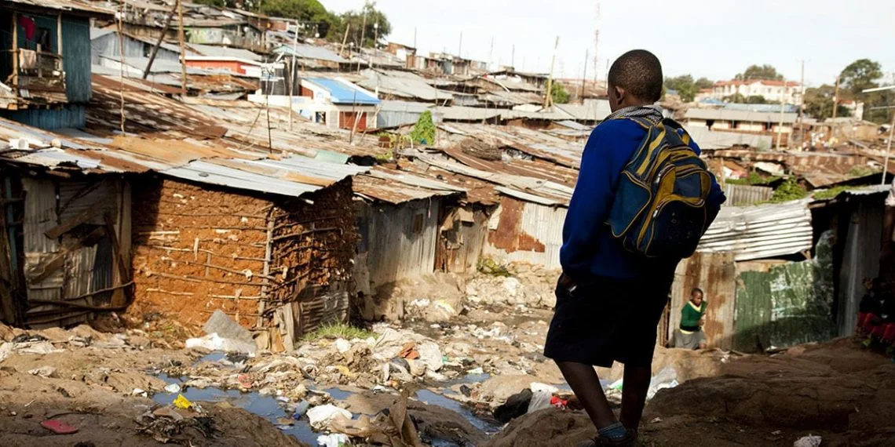
Defining Wealth
A CEO of international mission organisation “if you have a choice as to what you have for breakfast, then you are in the world’s elite!”

Slide 4
Is there anything wrong with having plenty of asset and money?
When we compare ourselves to those around about us, we are sometimes left feeling inadequate
James 4:17 “Remember, it is a sin to know what you ought to do and then not do it”
He who dies with the most toys wins!
He who dies with the most toys - still dies!
Luke 12:15 And Jesus said to them, “Take care, and be on your guard against all materialism, for one's life does not consist in the abundance of his possessions.”
“He is no fool who gives what he cannot keep to gain what he cannot lose.”
Jim Elliot

Slide 5
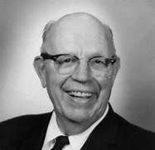
What constitutes God’s material blessing on someone as opposed to building independent wealth?
Abraham, Job, Solomon, Joseph of Arimathea
Bob LeTourneau
1888 - 1969
If you accumulate wealth to try and be independent of God, then this is a sin
The Bible repeatedly emphasizes that everything belongs to God (Psalm 24:1). Christians are managers, not owners, of resources
Jesus said “Wherever your treasure is, there the desires of your heart will be also” Matthew 6:21

Slide 6
What sort of wealthy people is James dealing with in our reading?
Come now, you rich, weep and howl for your miseries that are coming upon you! Your riches are corrupted, and your garments are moth-eaten. Your gold and silver are corroded, and their corrosion will be a witness against you and will eat your flesh like fire. You have heaped up treasure in the last days.
What were these wealthy people doing that got James so enraged?

Slide 7
We see in verses 4-7 of our reading some of the actions they were taking:
The wages of the labourers who mowed your fields, which you kept back by fraud, cry out
You have lived on the earth in pleasure and luxury; you have fattened your hearts as in a day of slaughter
You have condemned, you have murdered the just
He does not resist you

Slide 8
What was their condemnation?
Their wealth will rot away (verse 2)
Their greed will testify against them at judgement time (verse 3)
Their wealth will eat away at them like fire (verse 3)
What warnings did James give them?
Weep and groan with anguish for what is coming (verse 1)
The Lord of the Sabaoth has heard the cries (verse 4)

Slide 9
Conclusions
The pursuit of riches is a motivation for every conceivable sin
Paul’s declaration, “I have learned to be content whatever the circumstances” (Philippians 4:11)
Jesus said this: ‘You fool! This very night your life will be demanded from you. Then who will get what you have prepared for yourself?’
“This is how it will be with whoever stores up things for themselves but is not rich toward God.”

Slide 10
Are you rich to the world but poor toward God?
Have you learnt to be content in all situations?
Are you being generous when you have the opportunity?

Slide 11
James
Study 11
Woe to the Rich
James 5:1-6
Faith in Action

